Slide 1

TEAM 13
Road map of Sungkyunkwan University.

Slide 2
CONTENTS
Overview
Goals & Methods
Team & Strategy
Plan & Effects

Slide 3
PART 1
Overview

Slide 4
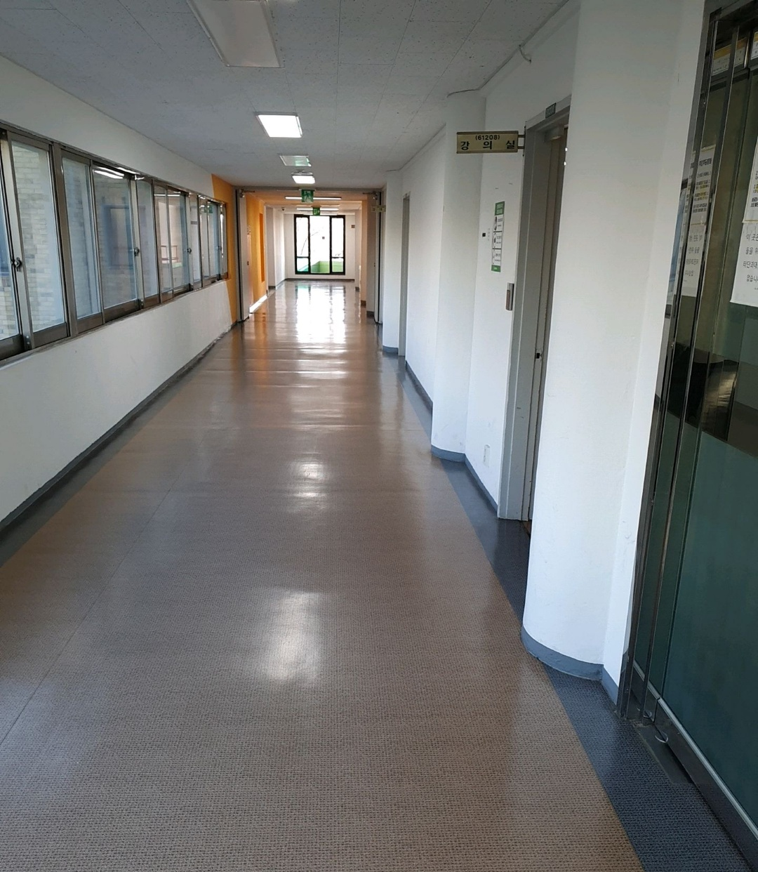

Background
Because of corona virus, students, professors and the others who work or study in university cannot visit school. People, especially freshmen or new students, may have difficulty locating the classroom when taking offline classes after Corona is over.

Slide 5

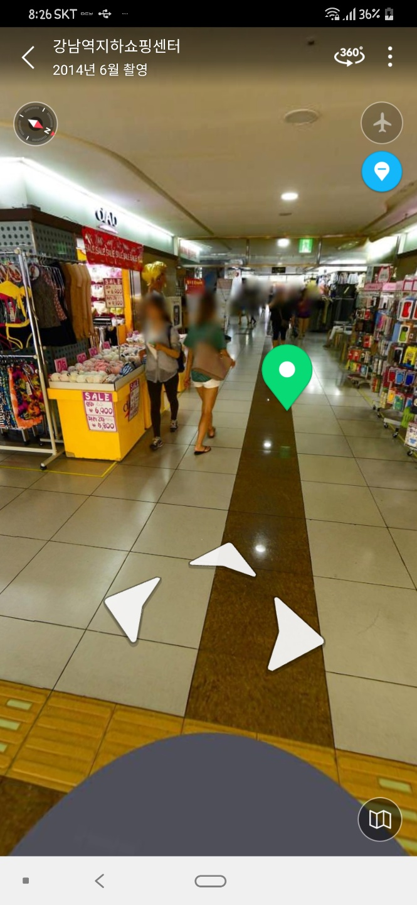
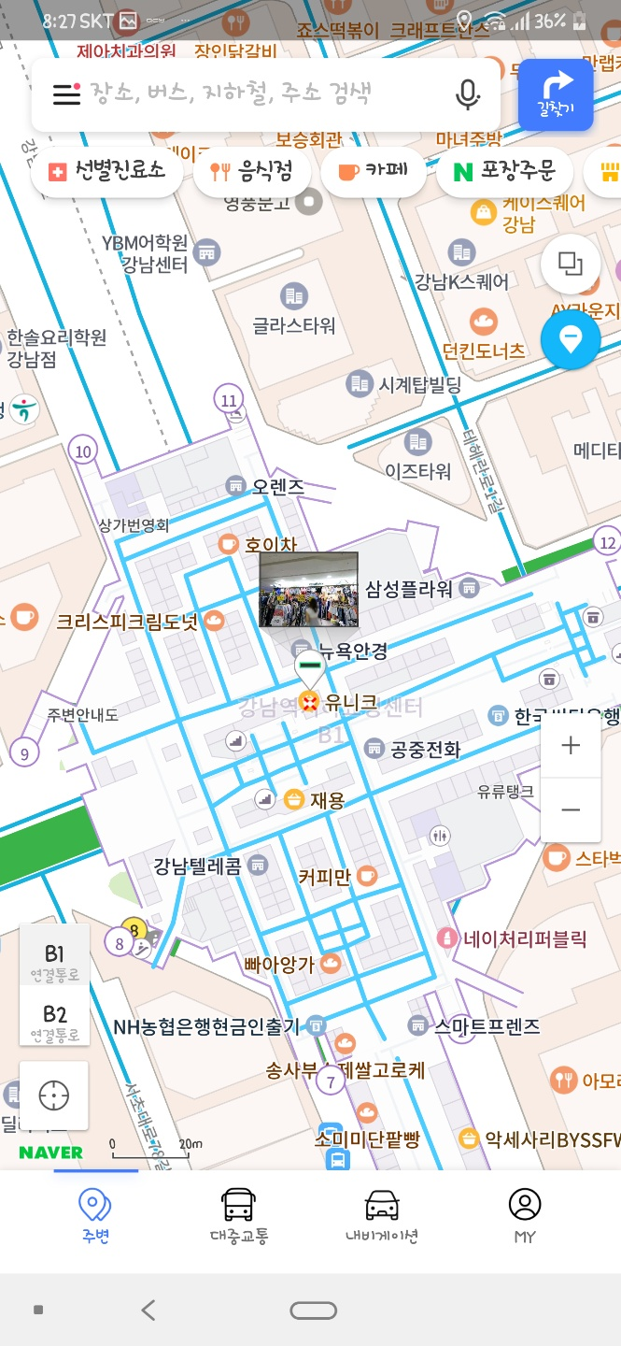
Background
Case 1
NAVER
Strength Point
We can see the inside of the building through the road view.
We can find the best path in the building.
We can use the arrows to see it as if it's actually going around.
Weak Point
It is limited to several buildings.
When indicating the location inside the building, it is not expressed which floor it is currently on.

Slide 6
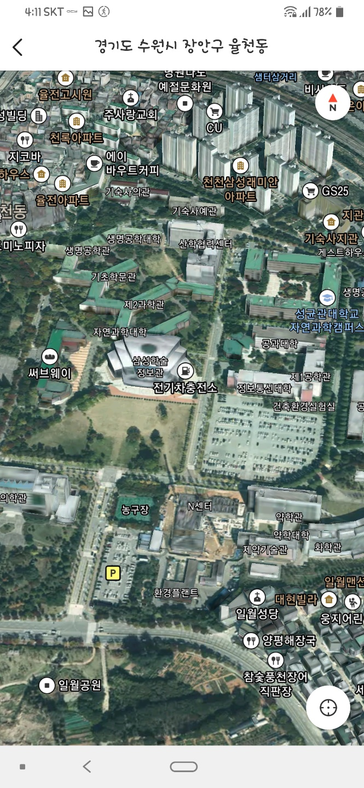
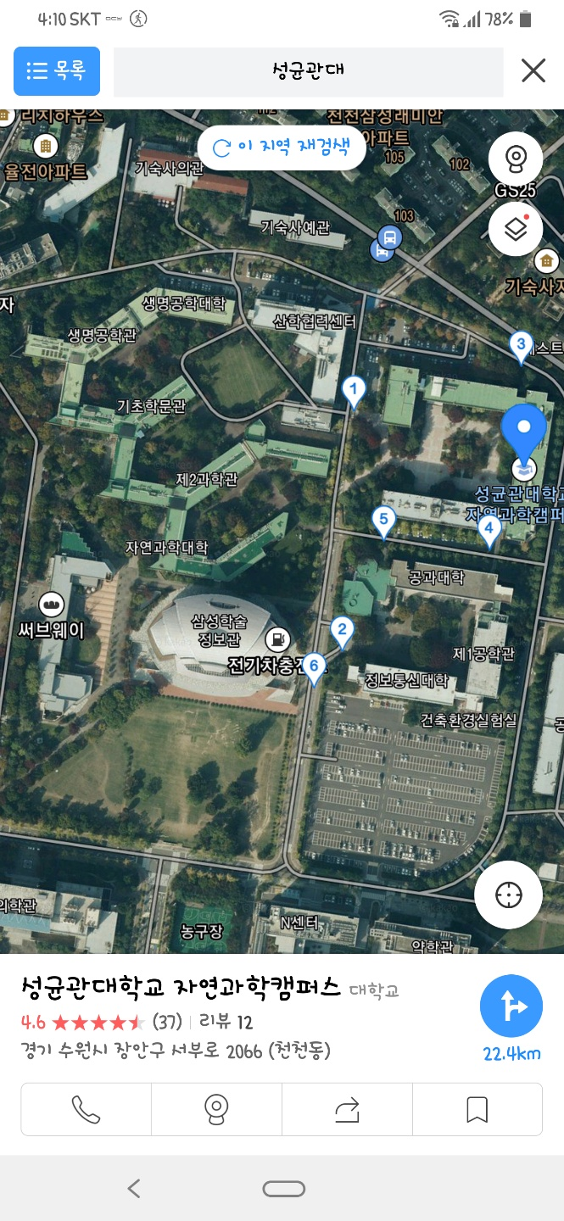
Background
Case 2
DaumKakao
Strength Point
Using 3D Skyview, we can see the building model with approximate height.
With Kakao app, we can share where we are now.
Weak Point
We cannot see the map inside the building.
Some road views point on the roadway so we can get confused with the sidewalk.

Slide 7
PART 2
Goals & Methods

Slide 8
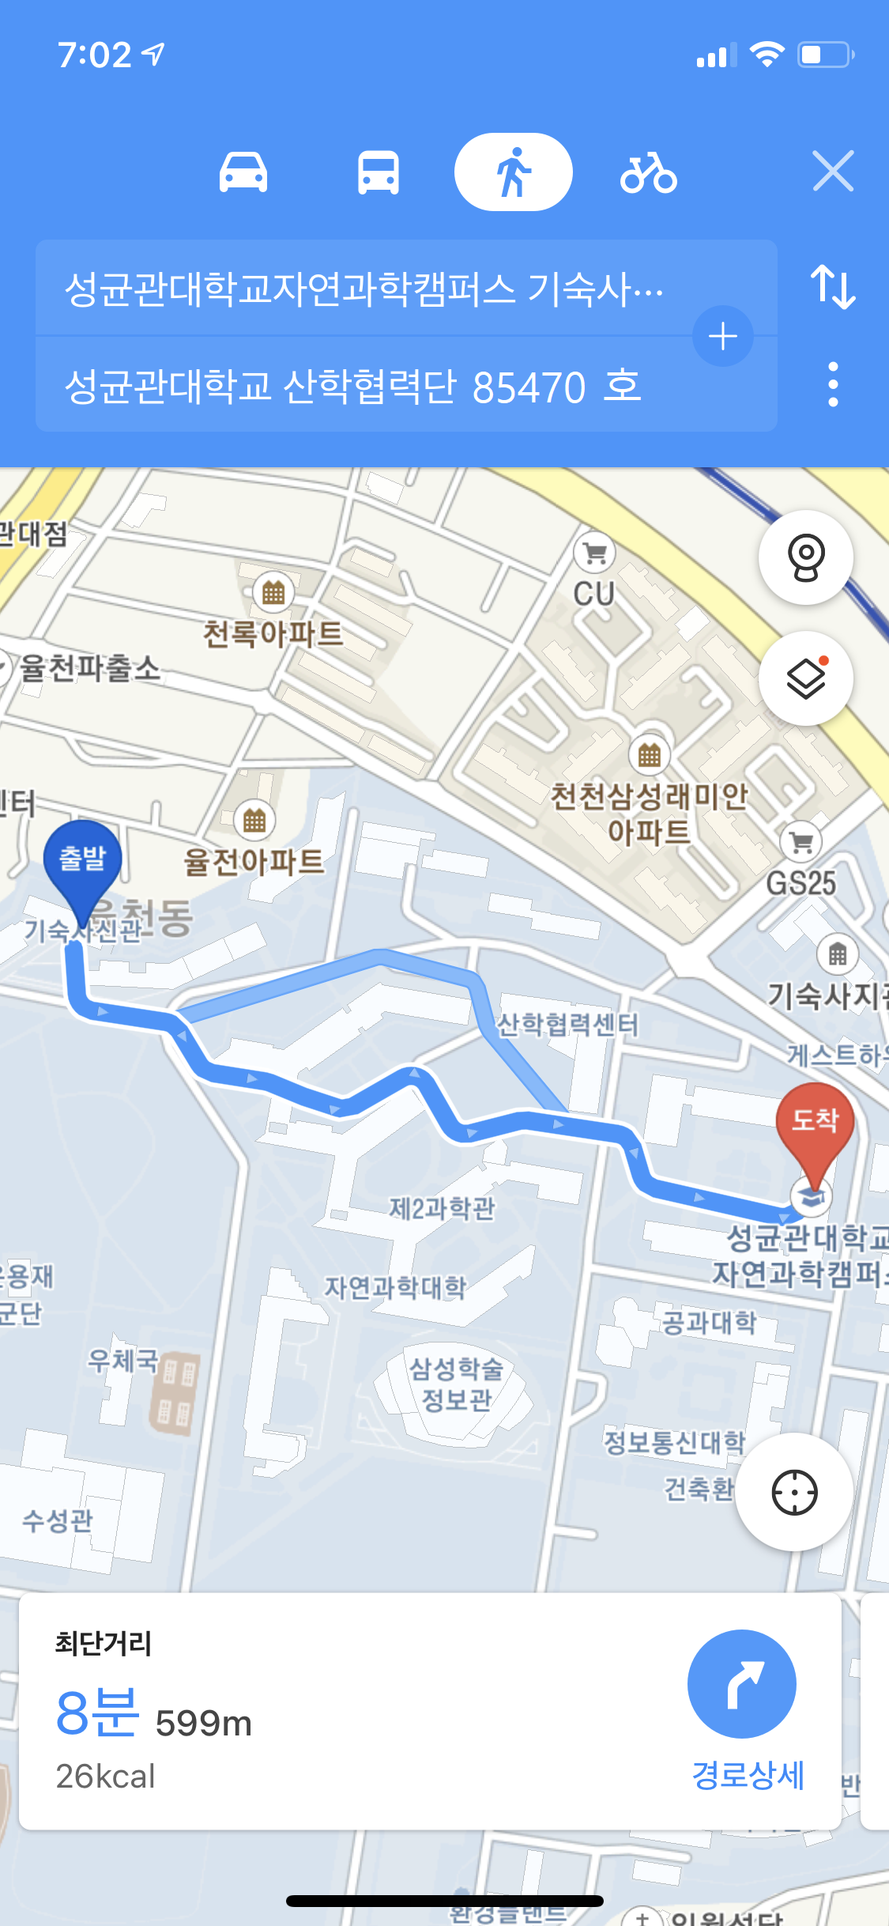
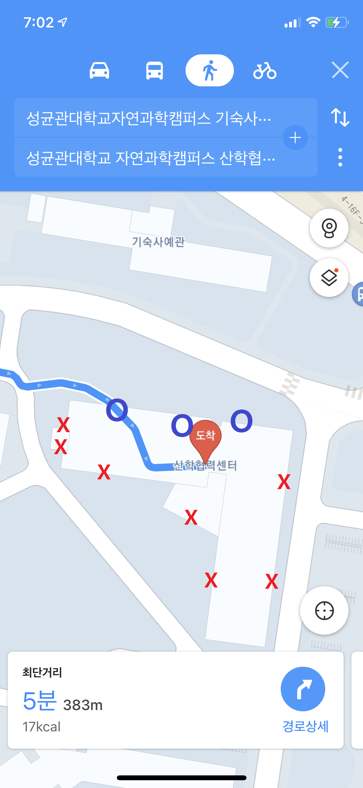
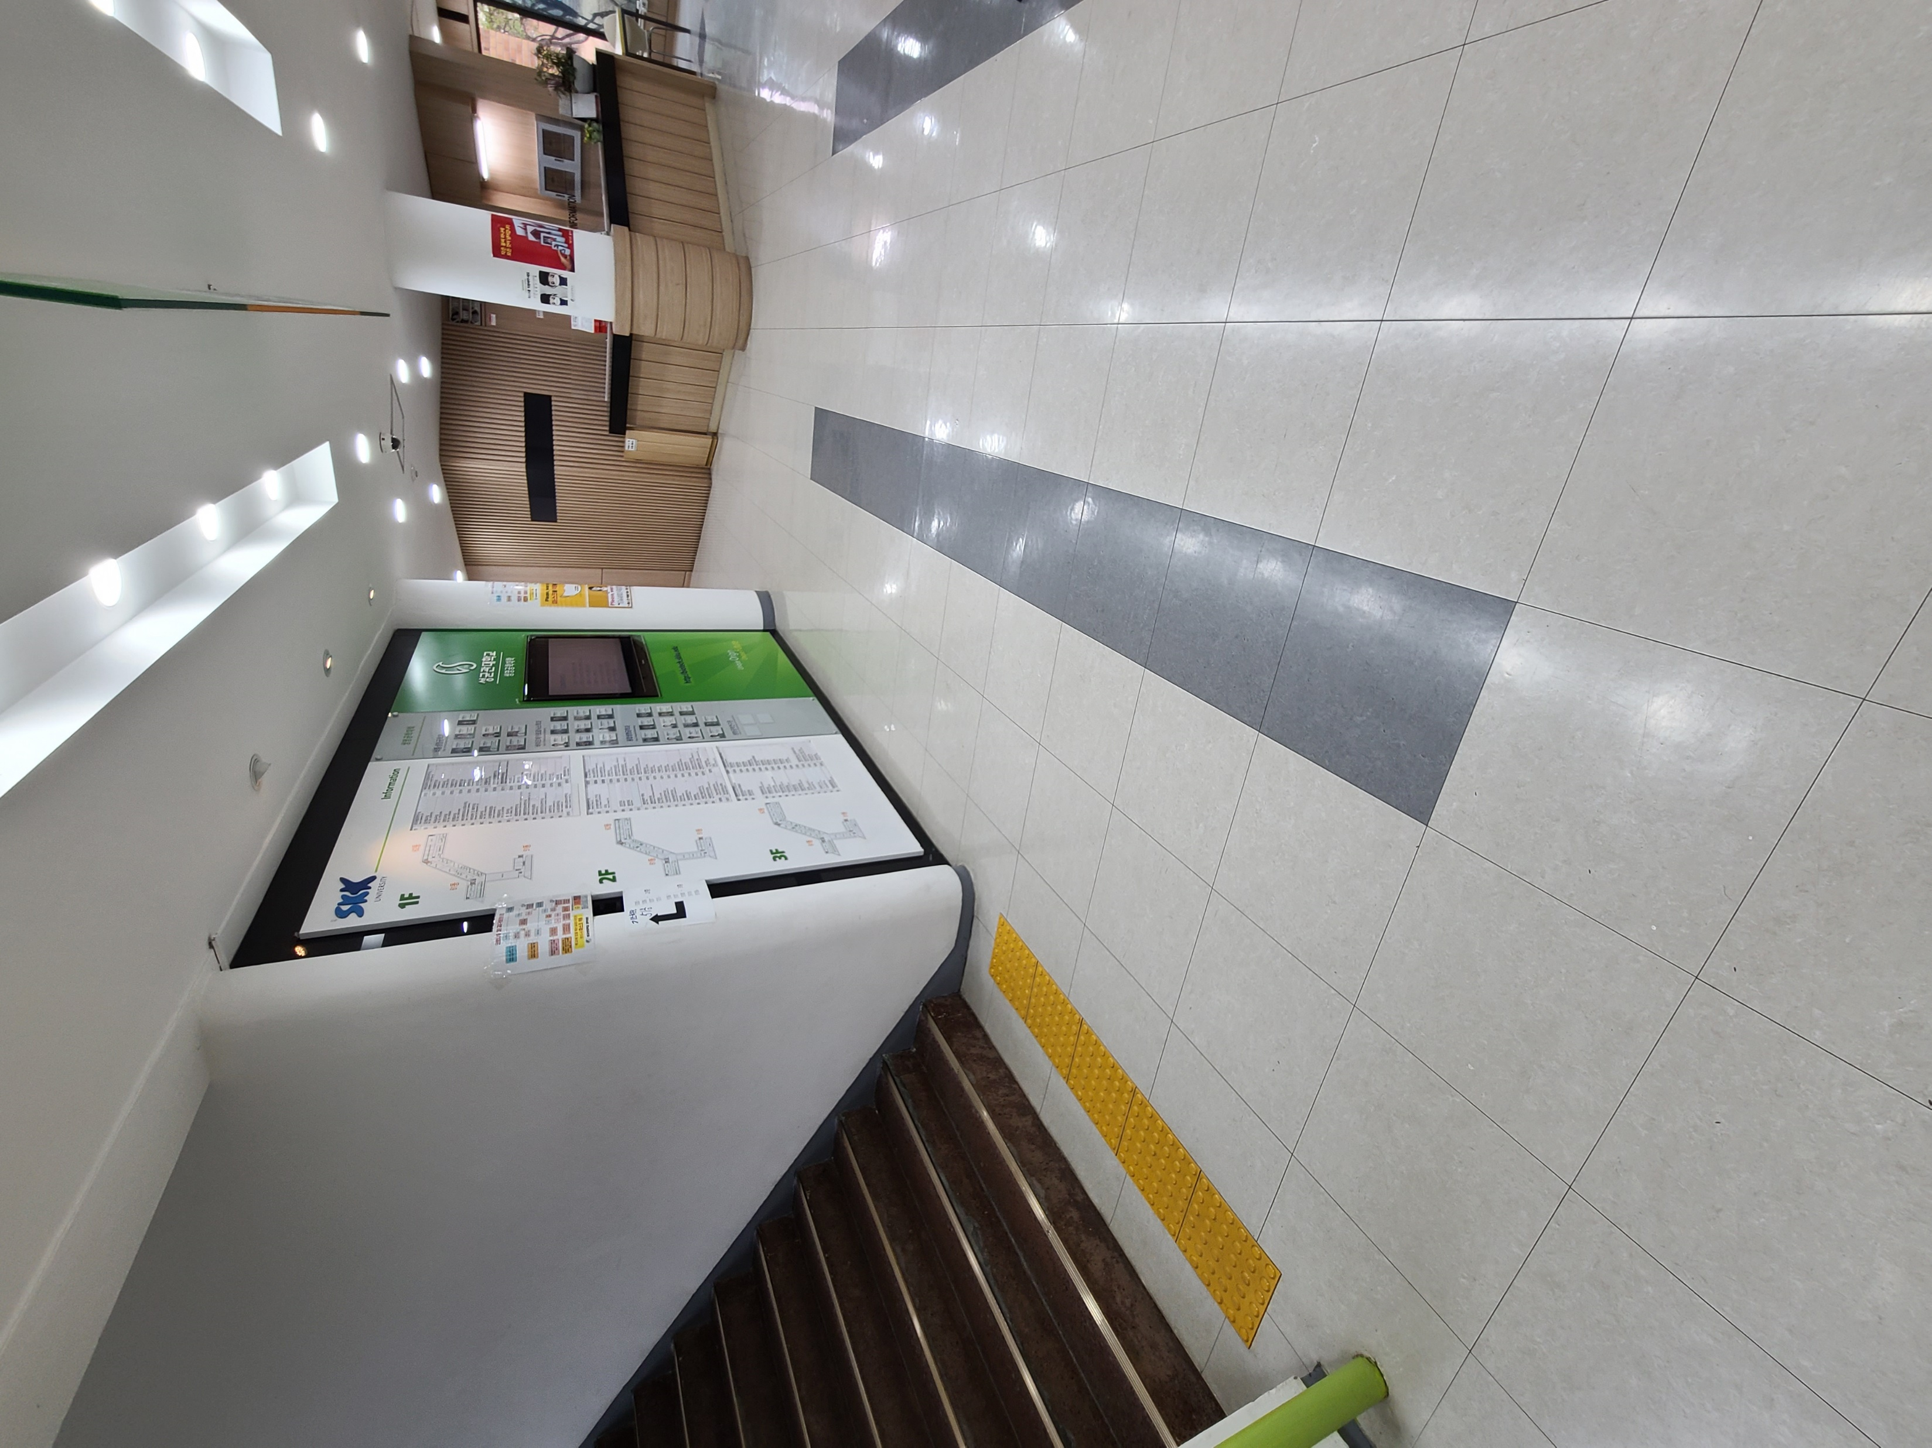
Final Goals We want to achieve
Navigation even in building to particular room
Shows available door to building ( ∵ locked due to COVID-19 & late night time)
Road view inside the building

Slide 9
Goals
Get to know inside the school Right Now
without any step

Slide 10
Goals – details
Main Point
Make map data inside each buildings
Data collecting with particular transportation(ex. Walk, bicycle, board) to Rooms in the buildings.
Develop more accurate GPS system using common GPS and Wifi system
Develop shortest path algorithm even guides to front of room, not building entrance.
Represent navigation route easily including stairs and elevator
Develop Road-map function showing inside the building

Slide 11
Methods – Main Points
Frontend
Backend
Extra Works
UI/UX Design
CI/CD
Shortest Path Algorithm
3D Panorama Pictures
Light App
Sending High Quality Map
Mapping Pics With GPS info
Get Accurate GPS info
Micro-service Architecture
Blur out sensitive Information

Slide 12
Methods – details
Our Apps Provides
Direction guide inside buildings
Notice duration of time by Transportation (by walks, bicycle, board)
Road view inside building
Map inside building which shows # of room
Notes:
서비스 정리
1 . 건물 내부 경로 안내
2 . 건물 내부 이동시간을 이동 수단 별 안내
3 . 건물 내부 로드뷰 기능
4 . 건물 내부 이동시, 건물 내부의 호수 분포도 제공
이를 위해 시스템에서 필요한 기능들
1 . 건물 내부까지 포함한 최단 경로 알고리즘 : 알고리즘 만들기 -> 출입구와 층 이동 수단에 따른 차이 고려 -> 실제 익숙한 이용자와 비교
2 . 건물 내부에서의 사용자의 위치정보 수집 : 사용자의 GPS정보 수집 + 근처 wifi 정보 -> 건물 내부까지 정확한 위치정보 파악
3 . 로드 뷰 데이터 수집 : 건물 내 3D파노라마 사진 촬영 -> GPS정보와 함께 지도와 위치 연동 -> 초상권 보호를 위한 모자이크 -> 플래시 뷰어에 맞게 데이터 변환
4 . 로드뷰 데이터 들을 압축되게 전달하여 빠른 시간에 로딩 필요 : 고화질 로드뷰 데이터 압축 -> 전송 및 수신 -> 앱에서 렌더링 하여 제공
https://blog.daum.net/x7000/15963259
로드뷰 제작 원리

Slide 13
Methods – details
In order to provide those, ~
Shortest Path algorithm
Define algorithm
Consider differences between entrances & stairs/elevator
Compare with user good at real world shortcut
Get accurate GPS information
User GPS info
Wifi info near by user
Accurate info even in building
Road View data
Get 3D panorama pic inside buildings
Mapping pics with GPS info
Blur out sensitive info
Converting to flash viewer
Fast map loaing
Compress high quality picture data
Send & Receive
Rendering in App
Notes:
서비스 정리
1 . 건물 내부 경로 안내
2 . 건물 내부 이동시간을 이동 수단 별 안내
3 . 건물 내부 로드뷰 기능
4 . 건물 내부 이동시, 건물 내부의 호수 분포도 제공
이를 위해 시스템에서 필요한 기능들
1 . 건물 내부까지 포함한 최단 경로 알고리즘 : 알고리즘 만들기 -> 출입구와 층 이동 수단에 따른 차이 고려 -> 실제 익숙한 이용자와 비교
2 . 건물 내부에서의 사용자의 위치정보 수집 : 사용자의 GPS정보 수집 + 근처 wifi 정보 -> 건물 내부까지 정확한 위치정보 파악
3 . 로드 뷰 데이터 수집 : 건물 내 3D파노라마 사진 촬영 -> GPS정보와 함께 지도와 위치 연동 -> 초상권 보호를 위한 모자이크 -> 플래시 뷰어에 맞게 데이터 변환
4 . 로드뷰 데이터 들을 압축되게 전달하여 빠른 시간에 로딩 필요 : 고화질 로드뷰 데이터 압축 -> 전송 및 수신 -> 앱에서 렌더링 하여 제공
https://blog.daum.net/x7000/15963259
로드뷰 제작 원리

Slide 14



Methods To be used in Front-end
To design logo & icons to be used in Map
To design UI/UX and visualizing simpler map
To Deal with Cross-platform environment

Slide 15



Methods To be used in Back-end (early stage)
As Seamless Collaboration and Version Control System
As Backend (Server, DB) for speedy set-up at early stage
As CI/CD Tool

Slide 16




Methods To be used in Back-end
As Seamless Collaboration and Version Control System
For Micro-service architecture And easy to maintain
For Cloud environment and Version Control & CI/CD

Slide 17
PART 3
Team & Strategy

Slide 18
Team & Strategy
UI/UX + Front-end Team
김규용
App Design
한지명
App Design Implementation
Back-end Team
Server Team
신승환
Implement Algorithms
천주형
App Back-end Implementation
Waterfall
Model
황석진
Team Leader/Implement DB
김승호
Collect & Preprocess Data
Notes:
Design + Frontend팀 (UI/UX)
김규용 : Design Application
한지명 : Application Design Implementation
Backend 팀
신승환 : Implement Algorithms / Support other parts
천주형 : Application Backend Implementation
Server 팀
황석진 : Team Leader / Implement DB
김승호 : Collect & Preprocess data / Support other parts

Slide 19
Team & Strategy – Schedule
Contents | 4/5 ~ 4/25 | 4/26~5/16 | 5/17 ~ 5/30 | 5/31 ~ 6/13 | 6/14 ~
Requirement Specification
System & Software Design
System & Software Implementation
Collect & Preprocess Data
Test planning
Testing (Validation & Verification)
Operation & Maintenance

Slide 20
Team & Strategy – Testing Strategy
Component testing
System testing
Acceptance testing

Slide 21
Team & Strategy – Quantitative evaluation
Evaluation indicator | Quantitative | Importance
Accuracy testing to check algorithm really shows real shortcut | 95%↑ | 20%
Collection rate of building inside view data | 98%↑ | 25%
UI / UX user evaluation | 85%↑ | 20%
Shortcut path search speed | 3 Sec↓ | 20%
Accuracy of time duration through path | 90%↑ | 15%

Slide 22
PART 4
Plan & Effect

Slide 23



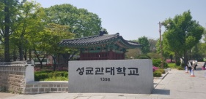
Application Plan
Can be extended to find a way between any two locations in Korea
Seoul to Busan, 1st floor to 3rd floor in same building.. Any two places!
Find A Way
You can get quick help from police officers and firefighters
Location and path accuracy save our life!
Rescue
Can be extended to find people around us
Get to know each other!
Find People
Any middle or high school students interested in university can have campus tour on their smartphone
Also useful for those who don’t or rarely go to campus
Campus Tour

Slide 24




Expected Benefits
Just click a button and get shortest path between classrooms in university
Can find path and location in easy, accurate way
Convenience
Use machine learning models with Wifi and GPS data
Get accurate location information even in building
Technology
Don’t have to find shortest path on your own
Save your time and energy
Economical
Easy promotion of campus to middle and high school students
Attract more students to the university
Promotion

